Slide 1
Re-Fridgerator
ARTH AKHOURI - J003
GAURAV ANKALAGI - J004
PARISHA BHATIA - J008
VIDHI KAPOOR - J021

Slide 2
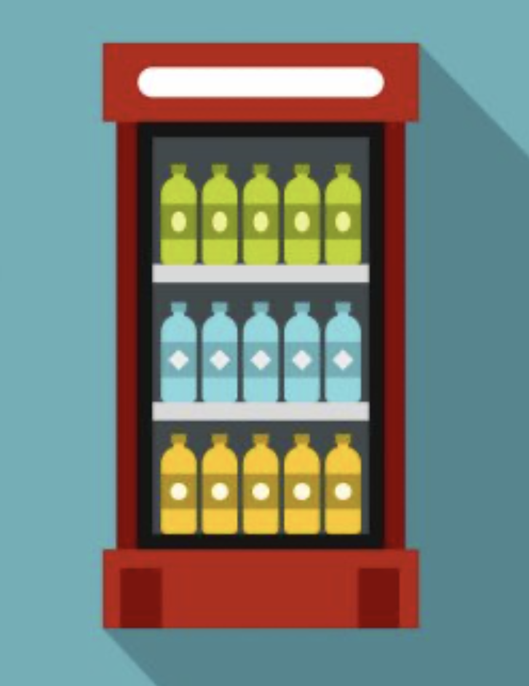
Problem Statement
In regular refrigerators, we have no way of knowing what is inside them without physically opening them.
Fridges at local shops or vendors have glass doors which always fog up because of condensation which render these glass door fridges useless.

Slide 3
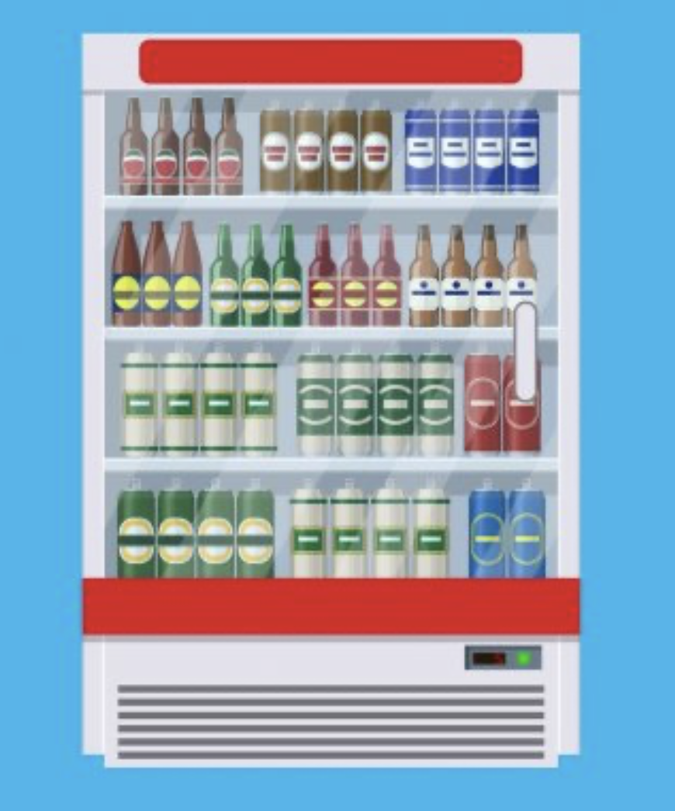
Our College Canteen - A Current Scenario Example
Our college canteen has a single glass door fridge in which different types of drinks and snacks are available.
The major problem in this scenario is that most of the times the fridge is quite full and we are unable to see stuff kept in the back because of the items right near the door.
Since we are not given the full array of choices, sometimes we end up not buying any thing.

Slide 4
Problems with the current scenario
Closed Door Fridge People cant see the things kept inside.
Glass Door Fridge Might tamper the sight due to condensation or the things might be too far behind so they might not be visible
Sometimes physically opening of fridge is required to check the customer’s requirement

Slide 5
Our Solution
We propose to make an accessory for a conventional fridge by converting it to a smart fridge which can keep track of things kept inside it and display exact amount of inventory inside on an LCD outside.
This accessory will keep a track of everything that is going in the fridge and also when it is taken out of the fridge.
We aim to track the contents of the fridge by scanning them first and constantly updating a local database for all the addition and the subtractions to the fridge.
+

Slide 6
How Our Solution Tackles The Problems
We can study trends using the data in the database and be better prepared for future stocking of the fridge.
Since there is an LCD display showing the contents, there is less need to open the fridge door and thus it saves electricity.
There is always a LCD display outside displaying the contents of the fridge.

Slide 7
Our Device
Our device has various components with different purposes which are described below :-
We use a flip switch to decide whether we are putting the products inside the fridge ( adding ) or products bottles from the fridge ( subtracting ) so we can perform the required actions in the database.
We have a barcode scanner at the door of the fridge which is connected to the raspberry pi using jumper wires.

Slide 8
Our Device
After selecting the mode of use we scan the bottle using a barcode scanner which is connected to a buzzer via raspberry pi so that the vendor/customer know that the barcode is scanned successfully
Raspberry pi is connected to the local database which is stored in a SD Card on the Raspberry Pi itself.
The database gets immediately updated and LCD screen connected to the raspberry pi will display the quantity of each product and the different types of variety available in it.

Slide 9

Components of our device
Local
Database
Barcode Scanner
LCD Display

Slide 10
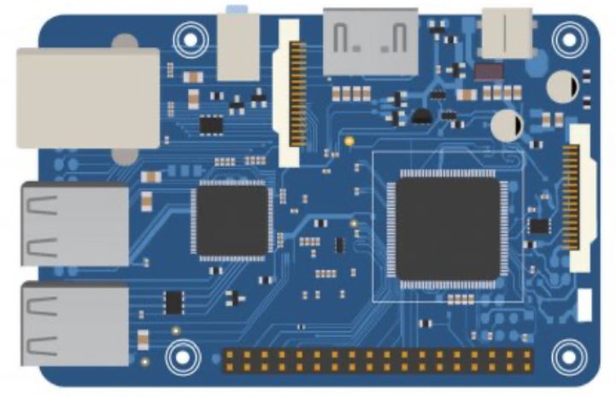
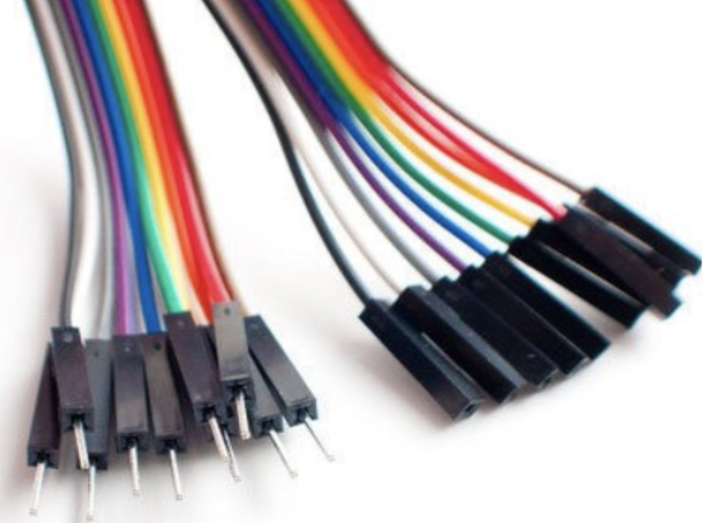
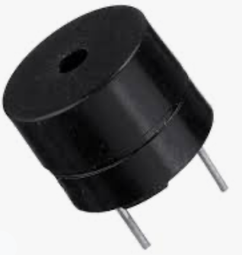
Components of our device
Raspberry Pi
Connecting Wires
Buzzer

Slide 11



Working
Local Database To Store The Fridge Contents
Take The Input From The Barcode And Constantly Update The Database And Display The Real Time Contents Of The Fridge
LCD Display To Display The Contents Of The Fridge
Barcode On Every Product Going Inside The Fridge
Barcode Scanner To Scan Every Product Going In The Fridge
Ringing Of The Buzzer Every Time A Product Is Scanned Successfully By The Raspberry Pi

Slide 12
Code Snippets
From gpiozero import buzzer
#setting up buzzer
bz= buzzer(3)
#Read new frame using barcode scanner
imshow (“reader”, frame);
reader.GetBarcodes(&result);
#when barcode is read activate buzzer
bz.on()
sleep(3)

Slide 13

Challenges with our
design
Scan every item before it goes in the fridge
A relatively large LCD display will be required to make the contents of the fridge visible to a large number of people
Will require additional power for the accessory

Slide 14
Future Scope
Integration into mainstream fridges.
Better tracking of products and sales.
Reduce time and effort taken to scan and put every product in the fridge.
Companies also save money on transportation by not sending goods to places where they record low sales.

Slide 15
Thank You
ARTH AKHOURI - J003
GAURAV ANKALAGI - J004
PARISHA BHATIA - J008
VIDHI KAPOOR - J021

